Slide 1

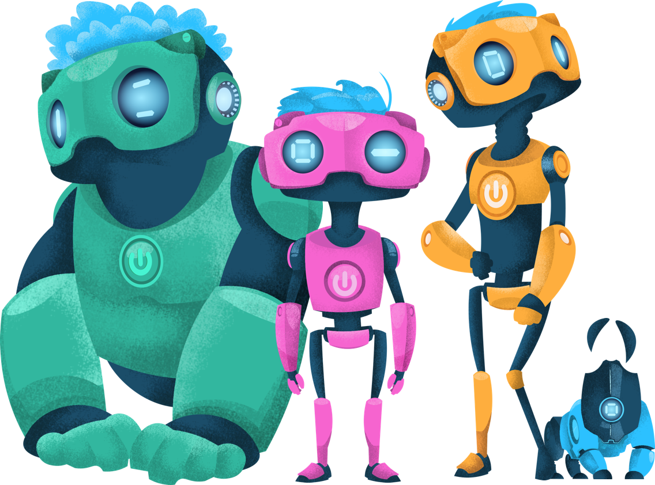

HOW AI IS
TRANSFORMING
SOFTWARE TESTING
www.testim.io
Raj Subramanian raj@testim.io
Notes:
v1

Slide 2


ABOUT ME
Developer Evangelist at Testim.io
Blogger, Speaker and Writer
http://www.rajsubra.com/blog/
https://blog.testim.io/
http://www.rajsubra.com/publications/
http://www.rajsubra.com/presentations/
11+ Years of Development and Testing
Twitter: @epsilon11
E-mail: raj@testim.io
www.testim.io
Notes:
AI is an area of computer science that emphasizes the creation of intelligent machines that work and react like humans.
ML evolved from the study of pattern recognition and computational learning theory (studying design and analysis of ML algorithms) in AI. It is a field of study that gives computers ability to learn without being explicitly programmed
DL is one of the many approaches to ML.Other approaches include decision tree learning, inductive logic programming, clustering and Bayesian networks. It is based on neural networks in the human body. Each neuron keeps learning and interconnects with other neurons to perform different actions based on different responses.

Slide 3
AGENDA
AGENDA
CURRENT CHALLENGES
HOW AI CAN SOLVE THESE CHALLENGES
LEARN THE BASICS OF AI
FUTURE OF AI

Slide 4
CONTEXT
CONTEXT
MATTERS
MATTERS

Slide 5





EVOLUTION OF TESTING
EVOLUTION OF TESTING
Manual Testing
Bulky Automation Tools
More Robust Automation tools + Open Source Frameworks
More about Scale
Autonomous Testing, Machine Learning and AI
1980 - 1990
1990 – 2003
2003 - 2010
2010 - CURRENT
THE FUTURE
Waterfall methodology
Experimentation with Different Development Approaches
Agile Approaches, faster release cycles
DevOps, Continuous Testing, CI/CD
Collaborative,
Smart testing
www.testim.io
Notes:
This is how testing has evolved
In the 1980’s majority of software development was based on the waterfall methodology. This meant that, teams first used to develop all the functionalities of a product making many assumptions and finally gave testers a chance to evaluate the product. As a result, there was a lot of wastage of time, effort and cost because defects were found late in the life cycle and there were huge turnaround time for each issue to get resolved. This in turn lead to delayed product launches and huge losses to organizations.
Then came the 1990’s, where all these automation tools started cropping up, making promises to provide solutions to most of the problems related to testing. It was refreshing for testers to know that, they finally have an aid of a tool to help in testing the product. But they came with their own baggage of being bloated with unnecessary features and it took a steep learning curve for testers to actually start using the tool effectively. The tools were also very unstable to say the least. We also started seeing people experimenting with different approaches as they were tired of the waterfall model. Some of these approaches included Scrum, XP (Extreme Programming), RAD (Rapid Application Development) and much more. The era of experimentation and innovation had started.
In the 2000’s, the era of open source frameworks began, there were like minded people wanting to share their knowledge with the community. They started encouraging innovation by getting other people involved in solving common problems related to test automation. During the same time, “Agile approaches” started becoming popular as they helped organizations to get to faster release cycles and improve efficiency.
From 2010 till current, it has been all about scale, so what do we mean by this? This era is all about how to write tests fast and find bugs faster. As a result, customers end up getting product updates even faster. There are 2 main factors that have contributed to this-
Crowdtesting - Organizations started realizing that, testing is a collaborative effort and started encouraging others to give feedback about their product by giving it in the hands of people who are passionate about testing and in no way closely connected to the product.
Cloudtesting - As the complexity of the software increased there was a need for more resources such as server space, faster processing, parallel execution and find failures much faster. Thus, cloud testing was born, where companies started providing these services to help organizations to get faster feedback on their product and not worry about spending too much time in maintaining the server infrastructure
Apart from just scale, we have seen considerable growth in companies focusing on DevOps, Continuous Testing and CI/CD Integration as well.
The future is going to be Autonomous testing using machine learning and artificial intelligence. Teams are going to move away from the use of “Static Locators” and start using “Dynamic Locators”.
Now we have the future
Autonomous Testing using Machine Learning and AI
Use dynamic locators instead of static ids
It is all about making testing simple, smarter, faster and more stable

Slide 6
CURRENT
CURRENT
CHALLENGES
CHALLENGES

Slide 7
HOW FREQUENT ARE
HOW FREQUENT ARE
YOUR RELEASES?
YOUR RELEASES?
FROM A RECENT SURVEY TESTIM COMPLETED
Not at all, we test last, we test quality into the product
13%
Testing involved early, but still have an extended test phase before release
57%
We could probably release after every sprint
19%
We could ship daily if we wanted to
10%
We could deploy any minute of any day
2%
www.testim.io
Notes:
From a recent survey Testim completed.

Slide 8
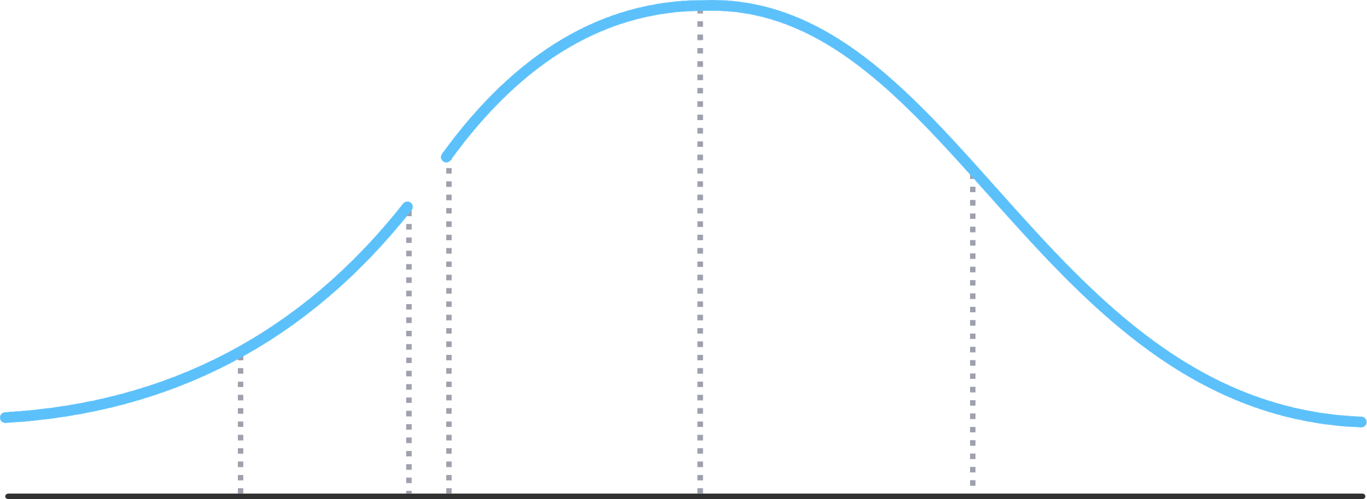
CURRENT CHALLENGES
CURRENT CHALLENGES
RAPID RELEASE CYCLES
RAPID RELEASE CYCLES
Chasm
Laggards 34%
Late Majority 34%
Early Majority 34%
Early Adopters 13.5%
Innovators 2.5%
Every 6 month
Every month
Every two weeks
Every day
5 times
a day
www.testim.io

Slide 9


THE CHALLENGE:
THE CHALLENGE:
#1 SKILL SET
#1 SKILL SET
Chasm
Laggards 34%
Late Majority 34%
Early Majority 34%
Early Adopters 13.5%
Innovators 2.5%
Every 6 month
Every month
Every two weeks
Every day
5 times
a day
www.testim.io
www.testim.io
Notes:
Skill set
There are not enough skilled testers and doing only manual testing
Skilled Testers are expensive
Some organizations have only manual testers and there is a steep learning curve

Slide 10



THE CHALLENGE:
THE CHALLENGE:
#2 AUTHORING
#2 AUTHORING
Chasm
Chasm
Laggards 34%
Late Majority 34%
Early Majority 34%
Early Adopters 13.5%
Innovators 2.5%
Every 6 month
Every month
Every two weeks
Every day
5 times
a day
www.testim.io
Notes:
Now you have skilled testers and they just start authoring a number of tests without following best practices. They add some automation capabilities to the project
How to handle elements waits, reusable components, parameterization

Slide 11


THE CHALLENGE:
THE CHALLENGE:
#3 INITIALIZATION
#3 INITIALIZATION
Chasm
Chasm
Laggards 34%
Late Majority 34%
Early Majority 34%
Early Adopters 13.5%
Innovators 2.5%
Every 6 month
Every month
Every two weeks
Every day
5 times
a day
www.testim.io
Notes:
People start paying attention to initial state of tests
Imagine a tester that wrote one test, and it passes now successfully, they run it again, only to find that state of the app is different, and needs to be reset
Login Scenario - Need to check whether a user is already logged in or not
Adding items to a cart - Need to check for already added items in the cart
Developers started helping out to write tests

Slide 12
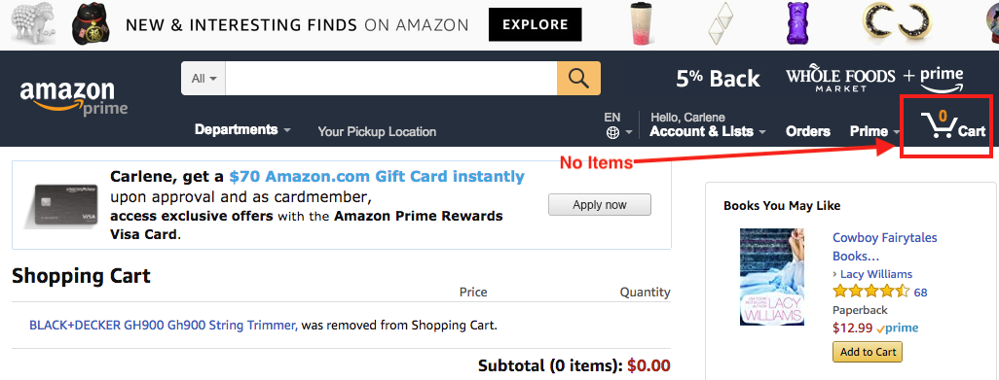
www.testim.io
Notes:
Amazon cart is an example for why setting initialization state is important.
You run a test to add items to the cart
You re-run the test and there already existing items in the cart. We need to handle this situation
Same scenario for login/logout as well. Taking care of initialization states is really important

Slide 13
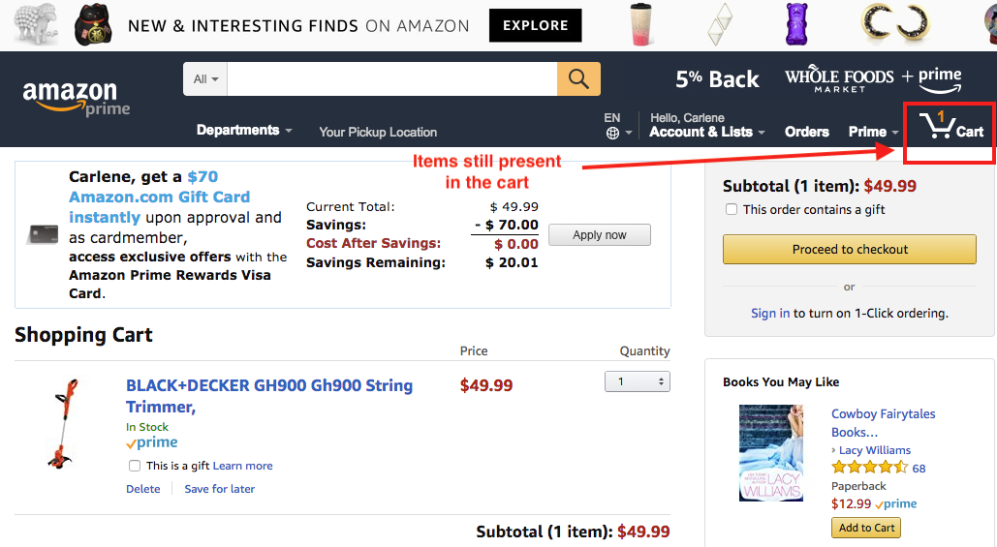
www.testim.io
Notes:
Amazon cart is an example for why setting initialization state is important.
You run a test to add items to the car
You re-run the test and there already existing items in the cart. We need to handle this situation
Same scenario for login/logout as well. Taking care of initialization states is really important

Slide 14


THE CHALLENGE:
THE CHALLENGE:
#4 MAINTENANCE
#4 MAINTENANCE
Chasm
Chasm
Laggards 34%
Late Majority 34%
Early Majority 34%
Early Adopters 13.5%
Innovators 2.5%
Every 6 month
Every month
Every two weeks
Every day
5 times
a day
www.testim.io
Notes:
We have 10 passing tests! We’re super happy!
I’m guessing you all can guess what this next challenge is
The next day, we come to work, and all the tests fail because of a change in the app.
BTW, according to recent surveys, this can be up to 30% of a tester work, and it's a big hinder in adding more tests
Now we start thinking about how to Maintain all this tests because there are some flaky tests and there is some refactoring which needs to be done to increase stability

Slide 15


THE CHALLENGE:
THE CHALLENGE:
#5 SCALE
#5 SCALE
Chasm
Chasm
Laggards 34%
Late Majority 34%
Early Majority 34%
Early Adopters 13.5%
Innovators 2.5%
Every 6 month
Every month
Every two weeks
Every day
5 times
a day
www.testim.io
Notes:
Next, we have 500 tests, which take 5 hours to run. Especially if they fail and find bugs, it’s really hard to release more than once a day
Tests need to written faster and the failures has been found fast if we want to release faster
Need to start thinking about scale
Whether the automated tests/framework are extensible
Need more server space for running
Need to run tests in parallel
Need to run the tests more often

Slide 16
BASICS
BASICS
OF AI
OF AI

Slide 17
DE-MYSTIFYING AI
DE-MYSTIFYING AI
Artificial Intelligence (AI)
Machine Learning (ML)
Deep Learning (DL)
www.testim.io
Notes:
AI is an area of computer science that emphasizes the creation of intelligent machines that work and react like humans.
ML evolved from the study of pattern recognition and computational learning theory (studying design and analysis of ML algorithms) in AI. It is a field of study that gives computers ability to learn without being explicitly programmed
DL is one of the many approaches to ML.Other approaches include decision tree learning, inductive logic programming, clustering and Bayesian networks. It is based on neural networks in the human body. Each neuron keeps learning and interconnects with other neurons to perform different actions based on different responses.

Slide 18

DEEP LEARNING EXAMPLE
DEEP LEARNING EXAMPLE
Size
Family Size
Bedrooms
Size
Price
Zip code
Walkable
Price
Wealth
School Quality
www.testim.io
Notes:
You give different Training sets to train the AI. Give input and output
Price of the house based on the size. That is what we want to know
You will feed the size (sq.ft) of the house and the price
Then you add data regarding bedrooms you want along with the price the AI may figure out Family Size as a factor based on this input
Then you add the zipcode and price, the AI may predict how walkable it is,
Then you add how wealthy that location is along with price,and AI may predict how it affects school quality
All the things that happen in the middle is a black box, we give only the input and the outputs to train the AI
Quickly cover
Supervised Learning - We are giving the right data for the algorithm to learn things
Give e-mail find out spam mail
Give audio and get text from it
Fill out a loan application and find the probability of the user repaying the loan
How to make user click on ads by learning their behavior
Un-supervised learning - We give a bunch of data and see what we can find
Taking a single image and creating a 3D model
Market Segmentation
Re-inforced learning - Based on concept of reward function. Good/Bad behavior. E.g. Training a Dog

Slide 19

www.testim.io
Notes:
This is not a new concept, This research was already done in 1989 and video published in 1992

Slide 20
DEMO: QUICK DRAW
DEMO: QUICK DRAW

Slide 21
HOW AI CAN SOLVE
HOW AI CAN SOLVE
THESE CHALLENGES
THESE CHALLENGES

Slide 22
www.testim.io

Slide 23
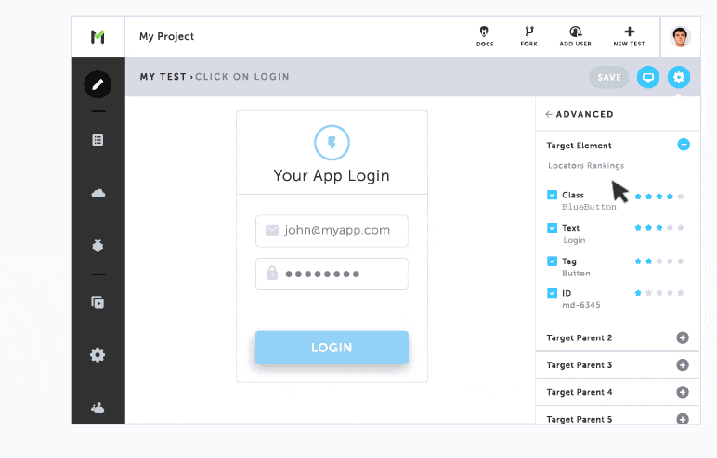
TESTIM.IO
TESTIM.IO
AI Based Locators
MULTIPLE ATTRIBUTES VS. SINGLE ONE
Hundreds of attributes used to identify elements
A few changes don’t break the test
LOW MAINTENANCE
No need to (tediously) update locators
MORE EXECUTIONS => MORE STABLE
With each execution we learn the changes to the application and optimize scores
www.testim.io
Notes:
Show Testim Demo
Dynamic Locators
Change in attribute still elements are stable
Reusable Components

Slide 24
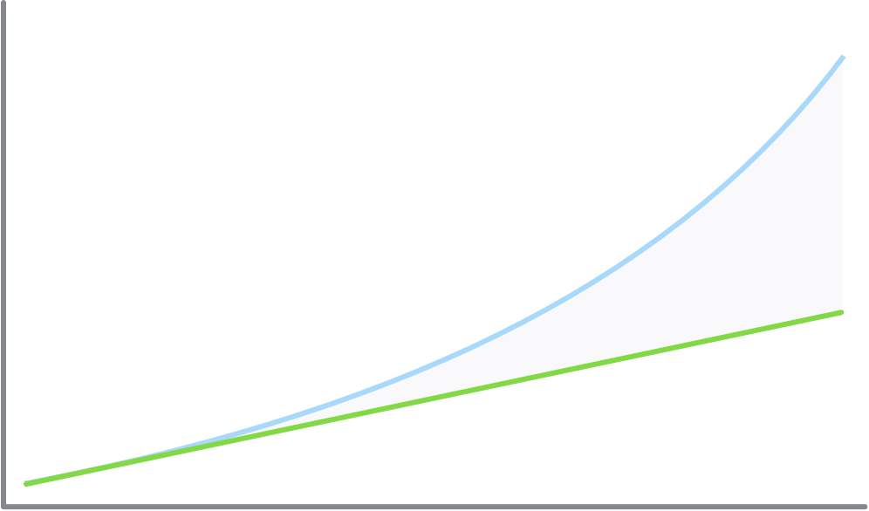
THE COVERAGE GAP
THE COVERAGE GAP
IN SOFTWARE TESTING
IN SOFTWARE TESTING
FEATURES
Complexity increases exponentially as new features and states interact with existing features
Complexity / Coverage
COVERAGE
GAP
TESTS
Test coverage grows linearly because they can only be added one at at time
Time
Source: Jason Arbon
www.testim.io

Slide 25
FUTURE
FUTURE
OF AI
OF AI

Slide 26

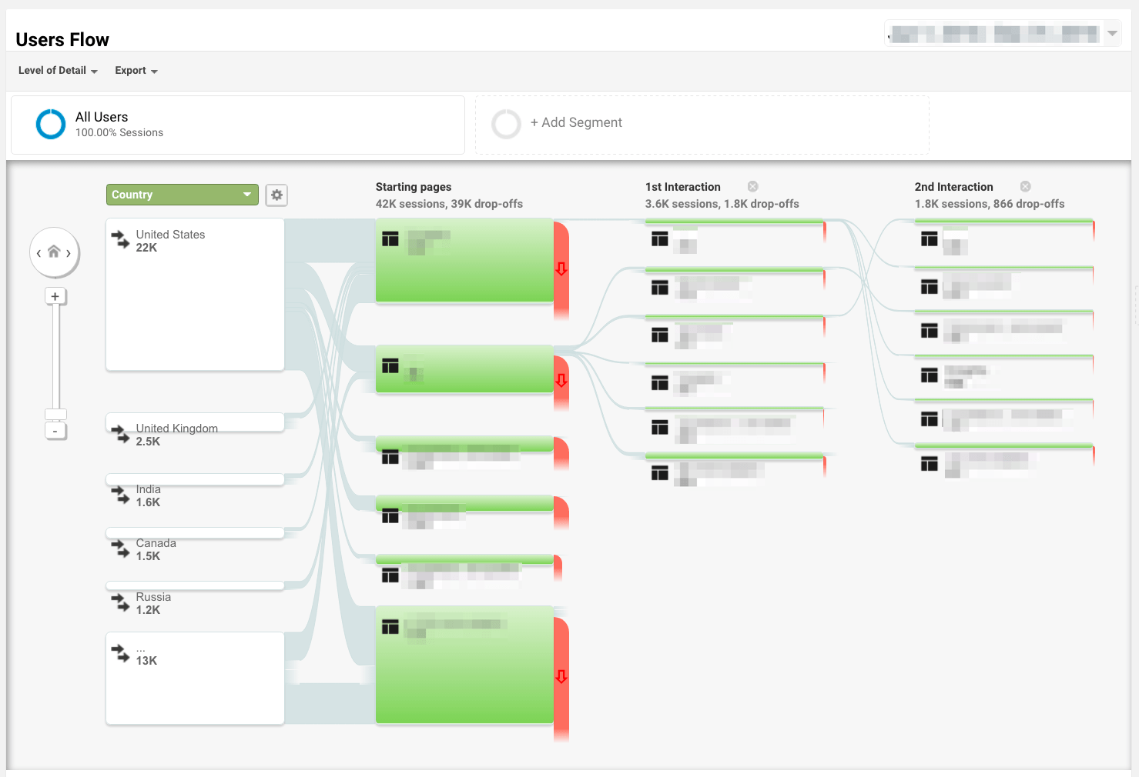
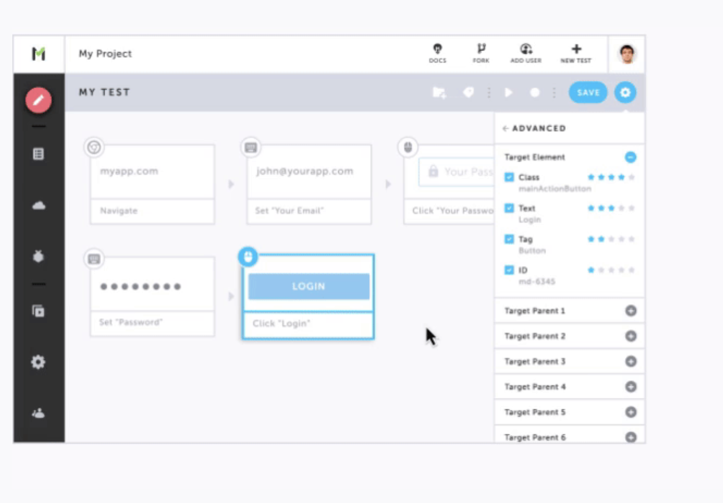
AUTONOMOUS
AUTONOMOUS
TESTING
TESTING
LEARN BY OBSERVATION (PRODUCTION)
AGGREGATE USER ACTIONS INTO FLOWS
TEST PRODUCED
FROM FLOWS
www.testim.io
Notes:
V1
We are going to make it easier for QA to do their job and maximize user coverage
Ability to create much more scenarios in a shorter period of time
Ability to take a risk based approach with true data driven decisions
Deploy resources much more effectively
Find bugs much quicker and repair them as opposed to fixing
In theory this is how we make QA a science
Suddenly your ahead of the game and proactively fixing issues instead of reacting to them, now you have something that is creating the tests proactively
Steve jobs has this quote about start with the user experience and work backwards

Slide 27
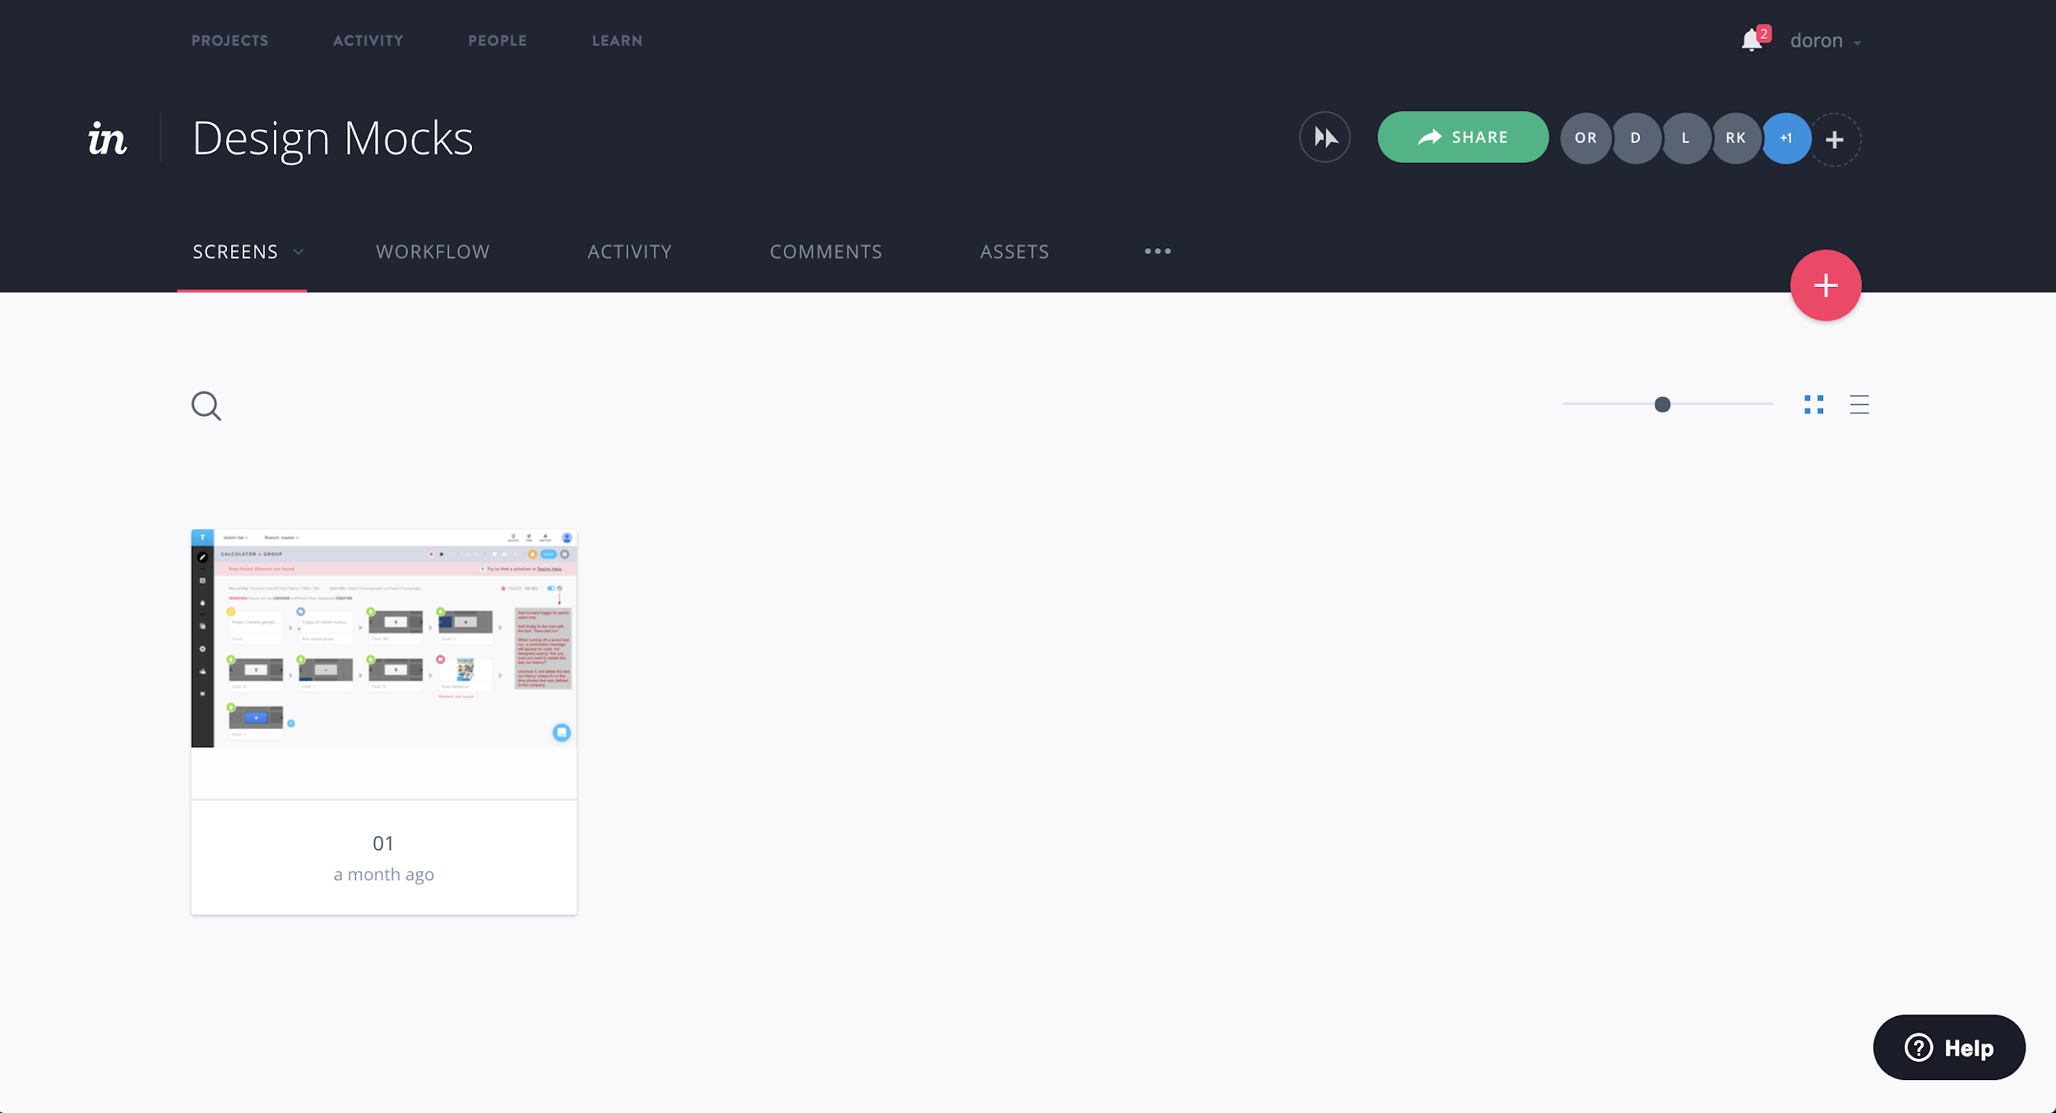

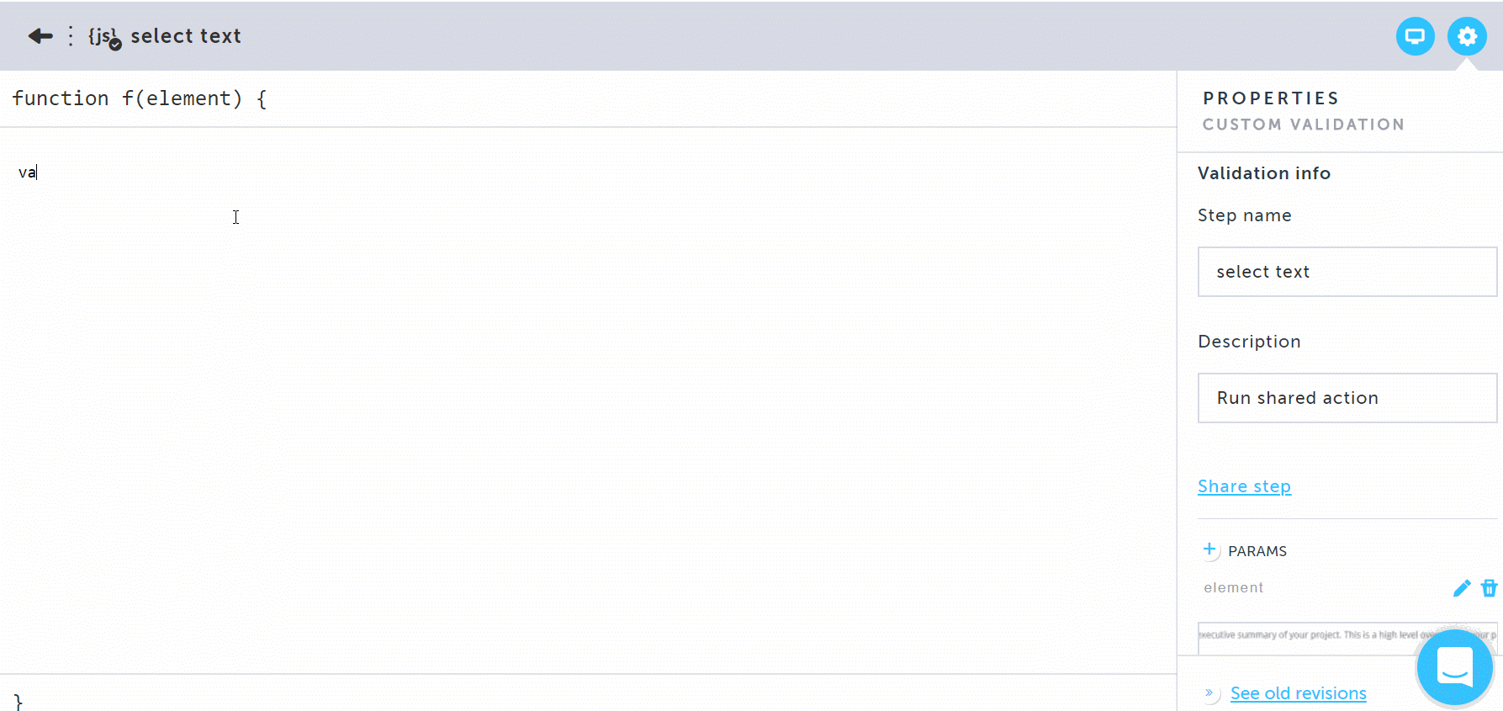

AUTHOR FASTER
AUTHOR FASTER
VIA UI TDD
VIA UI TDD
USE DESIGN MOCKS TO AUTHOR (IMAGE BASED)
RUN DURING DEVELOPMENT
UPDATE ON FIRST GREEN TEST
(MULTIPLE LOCATORS)
www.testim.io
Notes:
We are going to make it easier for QA to do their job and maximize user coverage
Ability to create much more scenarios in a shorter period of time
Ability to take a risk based approach with true data driven decisions
Deploy resources much more effectively
Find bugs much quicker and repair them as opposed to fixing
In theory this is how we make QA a science
Suddenly your ahead of the game and proactively fixing issues instead of reacting to them, now you have something that is creating the tests proactively
Steve jobs has this quote about start with the user experience and work backwards
You can start creating tests at the stage of the mock ups
Everything is much faster

Slide 28




1
CALL TO SERVER ARE RECORDED
AUTOMATIC RESPONSE
TESTS’ UI INTERACTION
RECORD
SERVER RESPONSE
SERVERS
AUTOMATIC RESPONSE
2
RESPOND WITH MOCKS
TESTS’ UI INTERACTION
PLAY
SERVER RESPONSE
SERVERS
www.testim.io

Slide 29



HOW TESTIM IS
HOW TESTIM IS
PAVING THE FUTURE
PAVING THE FUTURE
www.testim.io
www.testim.io

Slide 30

AUTONOMOUS TESTING ELIMINATES
AUTONOMOUS TESTING ELIMINATES
THE QUALITY/VELOCITY DILEMMA
THE QUALITY/VELOCITY DILEMMA
QUALITY
VELOCITY
Easier for QA to maximize user coverage
Take a risk based approach with true data driven decisions
Prevent bugs as opposed to fixing them
Create much more scenarios in a shorter period of time
Deploy resources much more effectively create the tests proactively
Dev/QA friction is minimized root cause analysis
www.testim.io
Notes:
Autonomous testing helps to eliminate the quality/velocity dilemma. In terms of quality, it makes it easier for QA to maximize user coverage by connecting authoring of tests with production apps mapping to real users flows. Now, we have the ability to take a risk based approach and base our decisions based on real data. Most of all, we are ahead of the game by proactively fixing issues instead of reacting to them through the self-healing mechanism of the AI. In terms of velocity, we are now able to create more user scenarios in short period of time. This means you can find bugs fast and release faster. The future of testing has become brighter with autonomous testing.

Slide 31
IT’S A
IT’S A
WRAP
WRAP
Email: raj@testim.io | Website: www.testim.io | Twitter: @epsilon11 | Youtube: Testim Channel

Slide 32
TALK
TALK
SUMMARY
SUMMARY
https://blog.testim.io/summary-blog-how-ai-is-transforming-software-testing/
www.testim.io

